Slide 1


Teachers and Teacher Aides Working Together
Teachers and Teacher Aides: Who Does What?
Module 1 Presentation

Slide 2
Introducing the module
The module is about the roles and responsibilities of a teacher and teacher aide.
It is for both teachers and teacher aides.
Please take your time to think and reflect.

Slide 3
Why this module?
Research shows that often:
  teacher aides are unsure about their roles
  teachers are unsure about their roles in relation to teacher aides.
How does the research compare with your experience as a teacher or teacher aide?

Slide 4

Why this module
This module helps teachers and teacher aides:
  develop a shared understanding of their roles
  build an effective working partnership.

Slide 5
Being clear about who does what
We need to:
be clear about and respect each other’s roles
know who to ask for support.
Who can you talk to in your school if you need help clarifying your roles?

Slide 6

Supporting teacher aides
Identify the key people who support teacher aides in your school.
Ensure teacher aides have access to school documents that set out the relevant policies, role descriptions and procedures.

Slide 7
Defining the role: teachers
Classroom teachers bear overall responsibility for the learning of all their students.

Slide 8

Defining the role: teacher aides
Teacher aides:
  work under the teacher’s
  guidance
  support the implementation
  of the classroom programme
  are not ‘helpers’ for individual
  students.

Slide 9

Supporting teachers
Teachers will get the most out of having support from a teacher aide when they:
  base the teacher aide’s work on the classroom programme
  know how their time will
  be used
  support and guide their day-to-day activities.

Slide 10
Getting together
Set up a regular meeting time during the teacher aide’s working hours.
Find ways to maintain ongoing communication.
What are some strategies that would help you to communicate better?

Slide 11
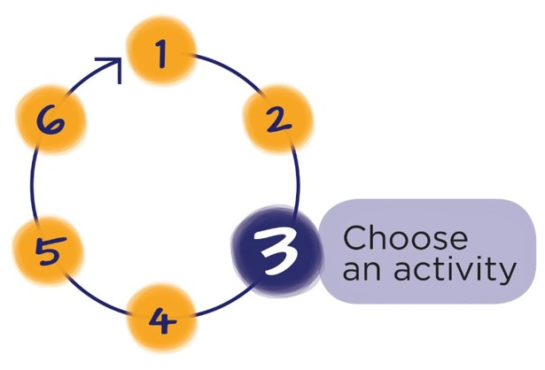
Next Step
Download the workbook for this module at: http://teachersandteacheraides.tki.org.nz/Teachers-and-teachers-aides/Our-roles/Module-1
To find out more about Teachers and Teacher Aides Working Together and to access the other modules go to:
teachersandteacheraides.tki.org.nz
We wish you well in your learning!
Ngā mihi!
It’s time to choose an activity from the workbook for this module.

