Slide 1
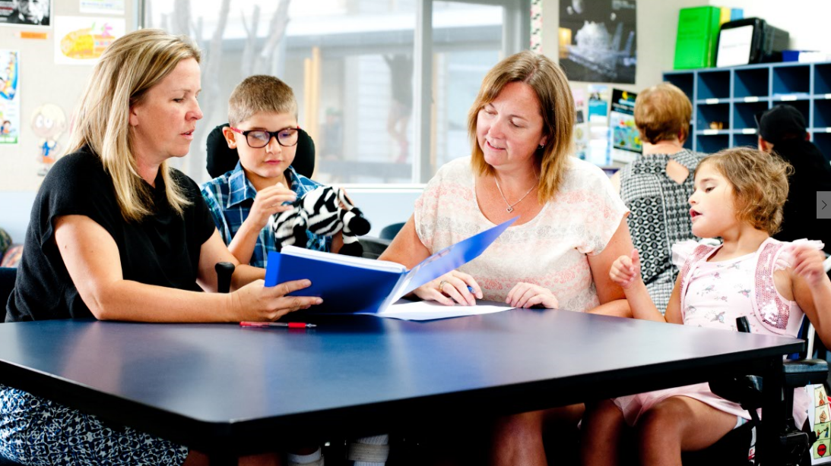

Teachers and Teacher Aides Working Together
Supporting Students with Complex Needs
Module 3 Presentation

Slide 2
Introducing the module
This module is about the provision of support for students who need physical, personal care and communication support.
It is for both teachers and teacher aides.
Please take your time to think and reflect.

Slide 3
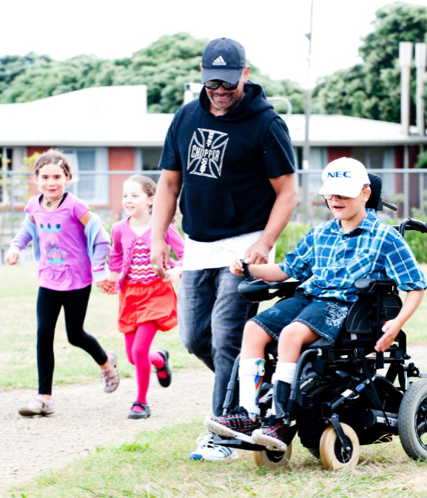
Why this module?
Some students require extra support at school for their physical and personal care and communication.
The purpose of this support is so that the student can access quality education.
Teacher aides are a valuable resource in contributing to this support.

Slide 4
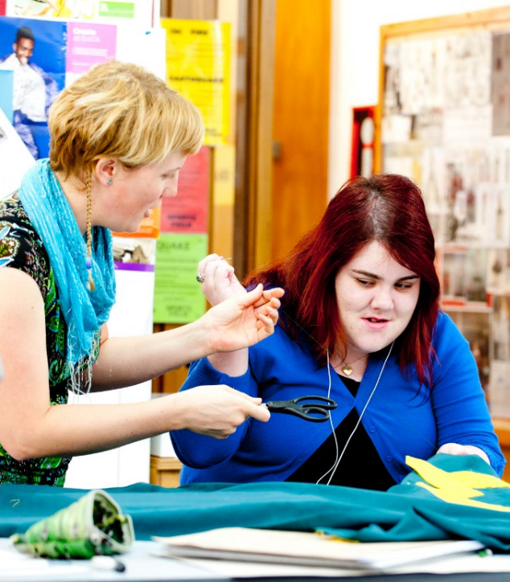
Why this module?
The ‘right kind of support’ for students with complex needs is provided with empathy and respect.
You may need access to appropriate training and support.

Slide 5
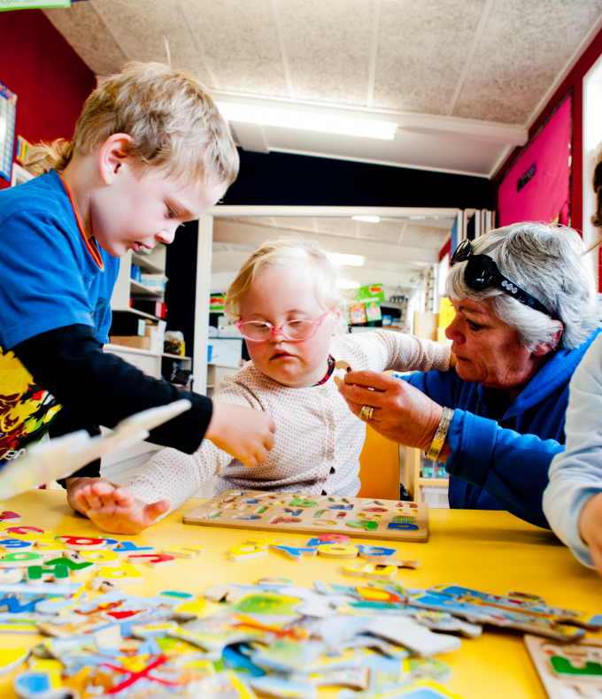
Being a role model
How you interact and include students with complex needs influences other students and how they treat their peers.
If you see and value the whole person, others are likely to do the same.

Slide 6
Respecting privacy and dignity
Some students need help with their physical and personal care.
This support should:
  be unobtrusive
  respect privacy and dignity
  empower the student.

Slide 7
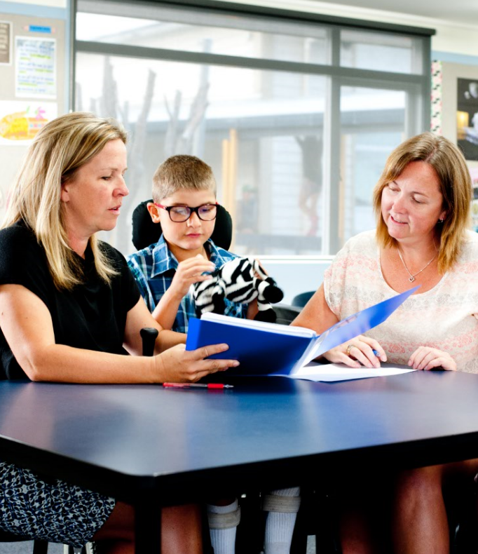
Respecting privacy and dignity
Find out what the student and their family and whānau want.
Talk to them and listen to what they have to say.

Slide 8
Seek the student’s views
Have I allowed the student to tell me what they want?
Have I asked the student what they prefer with physical transitions?
Do I speak to the student in the same way as other students?
Do I know what class or subject the student doesn’t want to miss so I can work around this?
How would I like to be treated?
Is there anything I think I should change?

Slide 9
Supporting students who require a high level of physical care
Some students require a health-care plan or a moving and handling plan.
A specialist may help develop the plan and show you how to aid the student.
The plan is available to those who work with the student, while respecting the student’s privacy.
See Health Conditions in Education Settings (Ministry of Education, 2006).

Slide 10

Supporting students with high communication needs
A specialist may show you how to work with assistive technology.
Show others how to work with assistive technology.
Model respectful ways of communicating.

Slide 11
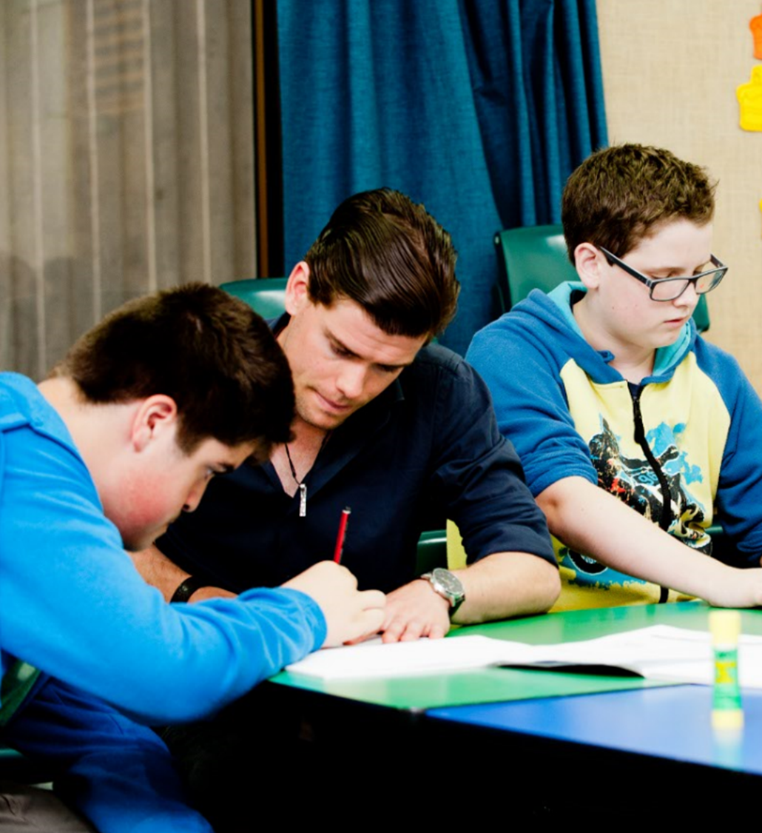
Supporting students with an individual education plan (IEP)
Some students will have an IEP.
An IEP is a collaboratively developed document that informs the student’s pathway to learning.
For more information, see Module 6 or Collaboration for Success (Ministry of Education, 2011).

Slide 12
Teamwork, teamwork, teamwork
Effective teamwork is important when supporting students with complex needs.
Team members have different skills and knowledge.
When everyone participates, the student benefits.
Think about a student you know who has complex needs. Who is on their ‘team’?
What knowledge and skills do they each bring?

Slide 13
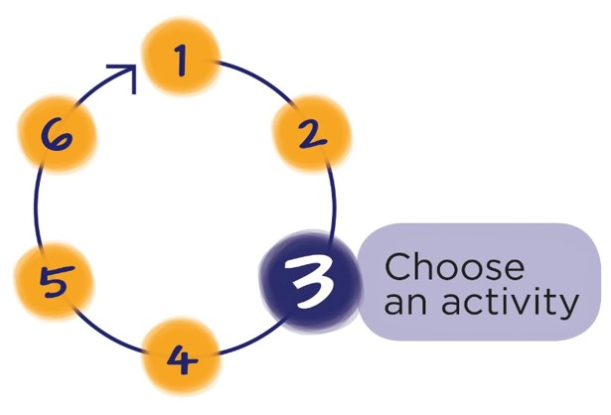
Next Step
Download the workbook for this module at:
teachersandteacheraides.tki.org.nz/Our-roles/Module-3
To find out more about Teachers and Teacher Aides Working Together and to access the other modules go to:
teachersandteacheraides.tki.org.nz
We wish you well in your learning!
Ngā mihi!
It’s time to choose an activity from the workbook for this module.

