Slide 1
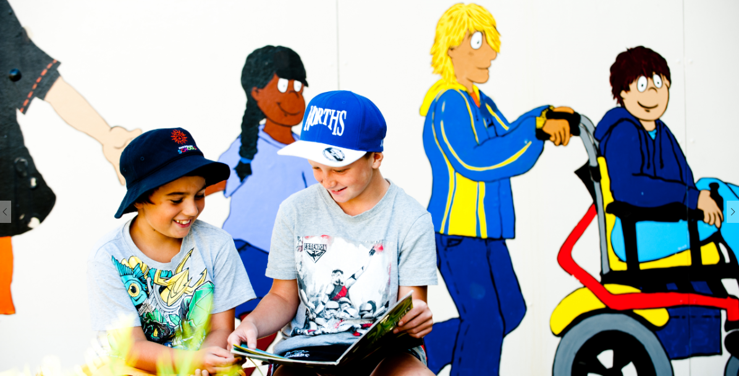
Teachers and Teacher Aides Working Together
What Do We Think about Disability and Diversity?
Module 4 Presentation

Slide 2
Introducing the module
This module is about educators’ attitudes and assumptions about disability and diversity and how this impacts on student learning.
It is for both teachers and teacher aides.
Please take your time to think and reflect.

Slide 3
Why this module?
While meaning well, teachers and teacher aides can often make assumptions that reduce the opportunities they give students to learn.
It doesn’t have to be that way!
It’s important for educators to examine and articulate their beliefs and assumptions about diversity, and how this impacts on student learning.

Slide 4
Examining our beliefs
All learners are active, capable and competent.
Educators who believe in their students’ capabilities create opportunities for them all to participate and learn.
This can require changes in our attitudes, behaviours and ways of working.
Have you ever prevented a student trying the same activities as their peers? Could you have unconscious beliefs about disability and diversity that are getting in the way of student learning?

Slide 5
Getting to know students
When we know our students well, we look past their disabilities.
We learn about their likes and dislikes, interests and capabilities.
How do you find out about the interests, capabilities and passions of the students you work with?

Slide 6
High expectations
High expectations reflect a belief that all students can succeed, regardless of their background or disability.
High expectations are self-fulfilling.
“Students who expect and are expected to succeed are more likely to succeed.”
(Ka Hikitia, MoE, 2013 p. 38)

Slide 7
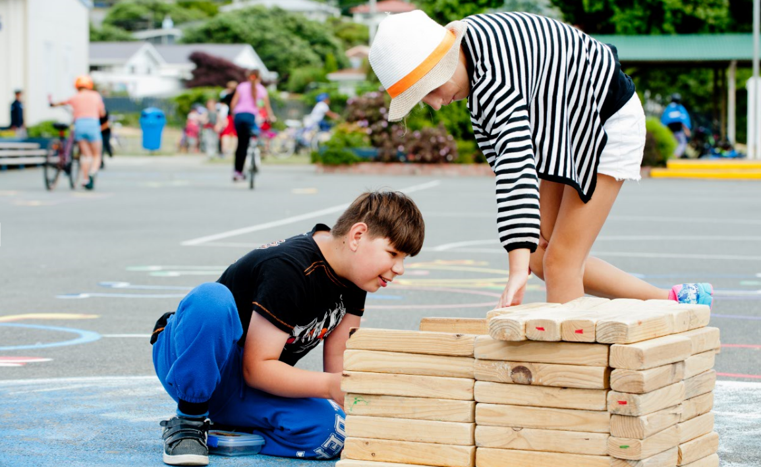
Lifting expectations
Low expectations are self-fulfilling too.
If we have low expectations, we need to examine our beliefs.
What are your expectations for students with additional learning needs? Are they less for some students than for others? How could you show all your students that you expect them to succeed in learning?

Slide 8
Valuing diversity
Diversity is about:
ethnicity
religion
sexuality
gender
first languages
disability.
“Students do better in education when what and how they learn builds on what is familiar to them, and reflects and positively reinforces where they come from, what they value and what they already know.”
Ka Hikitia (MoE, 2013, p. 38)

Slide 9
Valuing diversity
Value difference as a strength.
Acknowledge that identity, language and culture count.
Students do better when learning builds on what they know.
How do you connect to students’ identity, language and culture?
How do you help them connect this with their learning at school?

Slide 10
Ako – everyone is a teacher and a learner
“Ako describes a teaching and learning relationship where the educator is also learning from the student in a two-way process.”
Ka Hikitia (MoE, 2013, p. 16)

Slide 11
Ako
We can all learn from each other: teachers, teacher aides and students.
How is the principle of ako reflected in your practice? Who learns from who, and what is being learned?

Slide 12
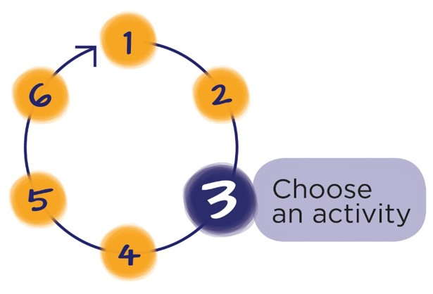
Next Step
Download the workbook for this module at:
teachersandteacheraides.tki.org.nz/Our-students/Module-4
To find out more about Teachers and Teacher Aides Working Together and to access the other modules go to:
teachersandteacheraides.tki.org.nz
We wish you well in your learning!
Ngā mihi!
It’s time to choose an activity from the workbook for this module.

