Slide 1
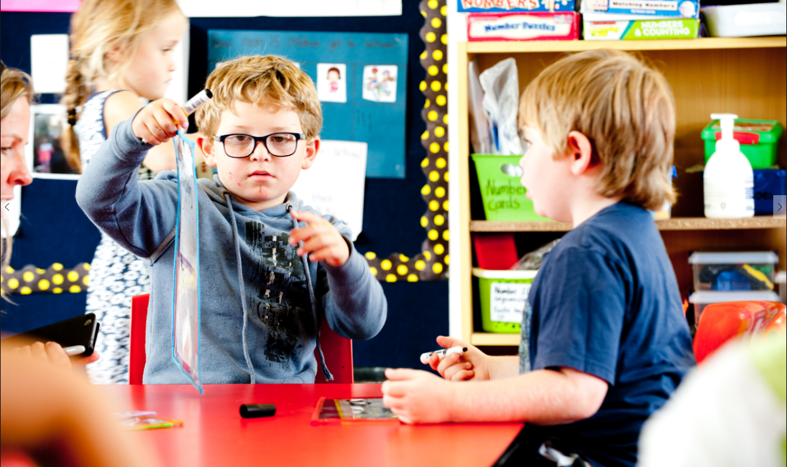

Teachers and Teacher Aides Working Together
Identifying Students’ Strengths
Module 5 Presentation

Slide 2
Introducing the module
This module is about identifying students’ strengths and building on these to enhance learning.
It is for both teachers and teacher aides.
Please take your time to think and reflect.

Slide 3

Why this module?
When we know what students can and love to do, we can use this to guide teaching and learning.
Narrative assessment and learner profiles can support a strengths-based approach.

Slide 4
Learning about your
students
We learn about students’ strengths and learning preferences by:
  talking to the student
  observing the student
  asking family and whānau
  finding out about the students’ strengths and skills outside of school.
How do you find out what students at your school enjoy doing and are good at?

Slide 5
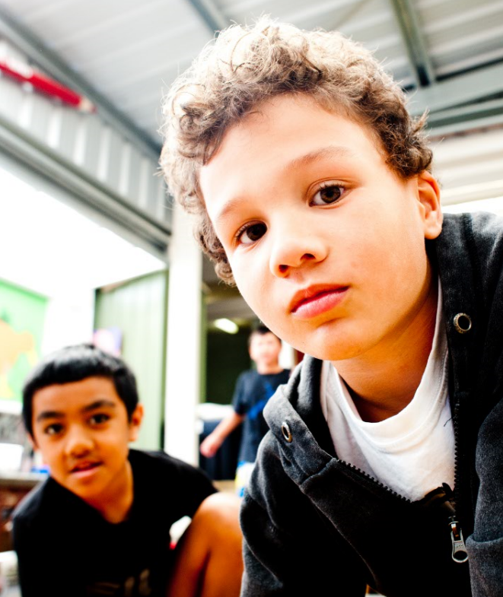
Assessment
Teachers use assessment to improve student learning and their own teaching.
Teachers are responsible for student assessment.
Teacher aides are responsible for supporting the teacher (e.g., by carrying out observations that the teacher has designed).

Slide 6
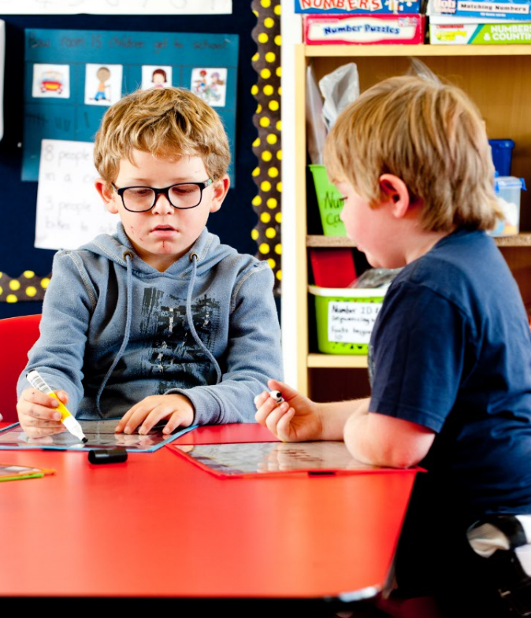
Using narrative assessment
Narrative assessment uses learning stories.
Learning stories describe what a student is doing in a certain situation or activity. They show the student’s interactions.
Learning stories draw on information from families and whānau, other teachers, peers and the student.
Information in the story is analysed to show what and how the student is learning in relation to the curriculum.

Slide 7
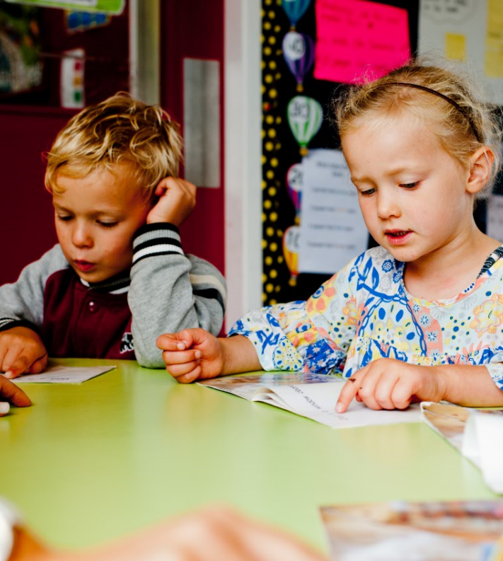
Benefits of narrative assessment
Narrative assessment is strengths-based because the learning stories show what a student can do and is learning.
It’s an effective way to show actual progress and plan next steps.
As with all assessment, observation and discussion are key.

Slide 8
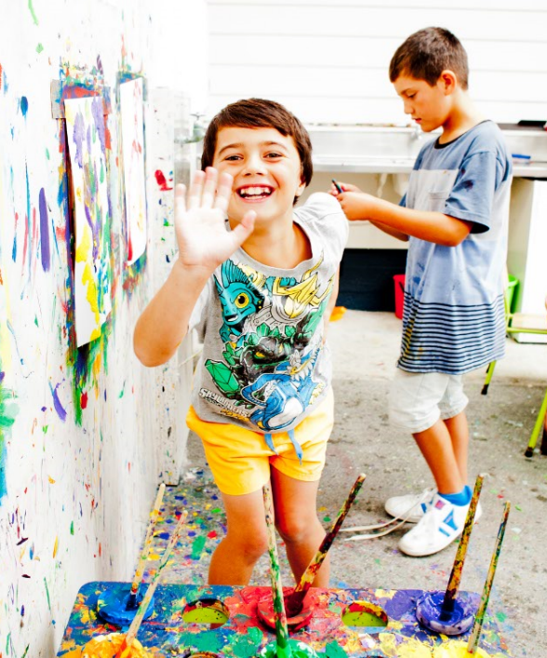
Learner profiles
Can be used to capture and celebrate what students can and love to do.
A profile can show a student’s:
  aspirations and interests
  strengths and skills
  barriers to learning and ways to address these.

Slide 9
Developing and using
learner profiles
Learner profiles can be created by the student or collaboratively with families, whānau and teachers.
Involving families and whānau means they can contribute their knowledge of their child and their preferences about how the profile is shared.
Learner profiles can be created for a variety of purposes.
How are learner profiles developed at your school? How are students involved in developing their own profiles?

Slide 10
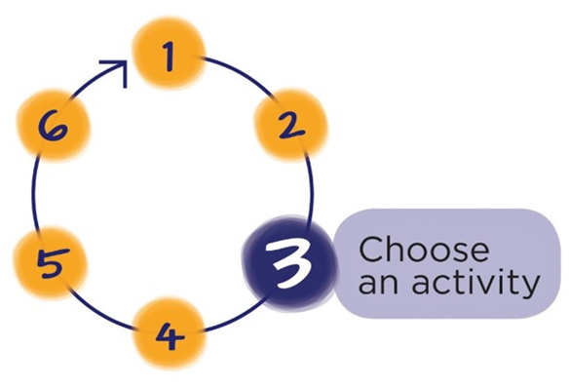
Next Step
Download the workbook for this module at:
teachersandteacheraides.tki.org.nz/Our-students/Module-5
To find out more about Teachers and Teacher Aides Working Together and to access the other modules go to:
teachersandteacheraides.tki.org.nz
We wish you well in your learning!
Ngā mihi!
It’s time to choose an activity from the workbook for this module.

