Slide 1
Teachers and Teacher Aides Working Together
Understanding the New Zealand Curriculum
Module 7 Presentation

Slide 2
Introducing the module
This module is about the New Zealand Curriculum.
It is for both teachers and teacher aides.
Please take your time to think and reflect.

Slide 3
Why this module?
Teachers and teacher aides develop a shared understanding of the New Zealand Curriculum and think about how to include all students.

Slide 4
How the New Zealand Curriculum relates to the classroom
The New Zealand Curriculum (NZC) provides a framework within which each school plans its own curriculum.
Teachers interpret the school curriculum to shape the curriculum in their classrooms.
Students experience a curriculum that reflects and is responsive to them and their communities.
“The New Zealand Curriculum sets the direction for teaching and learning in English-medium schools.”
(MoE, 2007, p. 37)

Slide 5
New Zealand Curriculum - overview
The curriculum includes:
a vision
principles
values
key competencies
learning areas.

Slide 6
NZC – vision
The vision is:
“for young people to be confident, connected, actively involved, and lifelong learners.”
(Ministry of Education, 2007, p. 8)
What does it mean to be a “confident, connected, actively involved, lifelong learner”?
Why is it important for young people to develop these attributes?
What do they need to know or be able to do to achieve them?

Slide 7
NZC – principles
What is important and desirable in a school’s curriculum.
The educational experience students are entitled to.
Inclusion is one of eight principles in the New Zealand Curriculum.
The others are:
high expectations
Treaty of Waitangi
cultural diversity
learning to learn
community engagement
coherence
future focus.

Slide 8
NZC – values
The values inspire communities to be supportive and strong.

Slide 9
NZC – key competencies
The key competencies enable students to live, learn, work and contribute to their communities.
The five key competencies:
thinking
using language, symbols and texts
managing self
relating to others
participating and contributing.
How are the students you work with encouraged to develop these competencies?

Slide 10
NZC – learning areas
There are eight learning areas:
the arts
English
health and physical education
learning languages
mathematics and statistics
science
social sciences
technology.
Access to learning in each learning area is important for all students.

Slide 11
The NZC – for every student
“All New Zealand students … should experience a rich and balanced education that embraces the intent of the national curriculum.”
(Ministry of Education, 2007,
p. 37)

Slide 12
Making the curriculum accessible
Ideally, the curriculum is designed to be accessible to all students.
Universal Design for Learning is a model teachers can use to plan an inclusive curriculum.
It recognises that we are all unique, so it builds in flexibility.

Slide 13
Making the curriculum accessible
To make the curriculum accessible, changes can be made to:
content
teaching and learning materials
the responses expected from students.
Adaptations = changes to environments, materials and strategies.
Differentiations = changes to content and expected responses to the curriculum.

Slide 14
Curriculum – who does what?
Teachers plan, develop, review the curriculum and make changes.
Teacher aides help implement the classroom programme.
What are some great ways you’ve seen or experienced where teachers and teacher aides have worked together to include all students in the classroom curriculum?

Slide 15
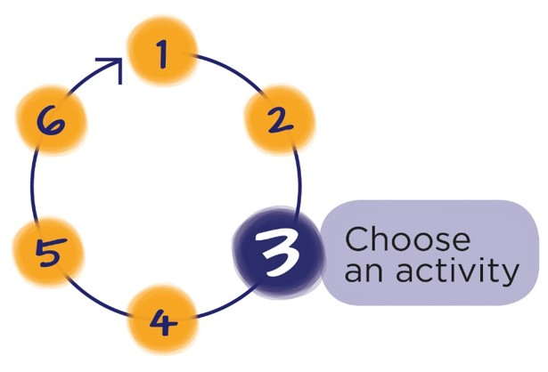
Next Step
Download the workbook for this module at:
teachersandteacheraides.tki.org.nz/Our-work-together/Module-7
To find out more about Teachers and Teacher Aides Working Together and to access the other modules go to:
teachersandteacheraides.tki.org.nz
We wish you well in your learning!
Ngā mihi!
It’s time to choose an activity from the workbook for this module.

