Slide 1
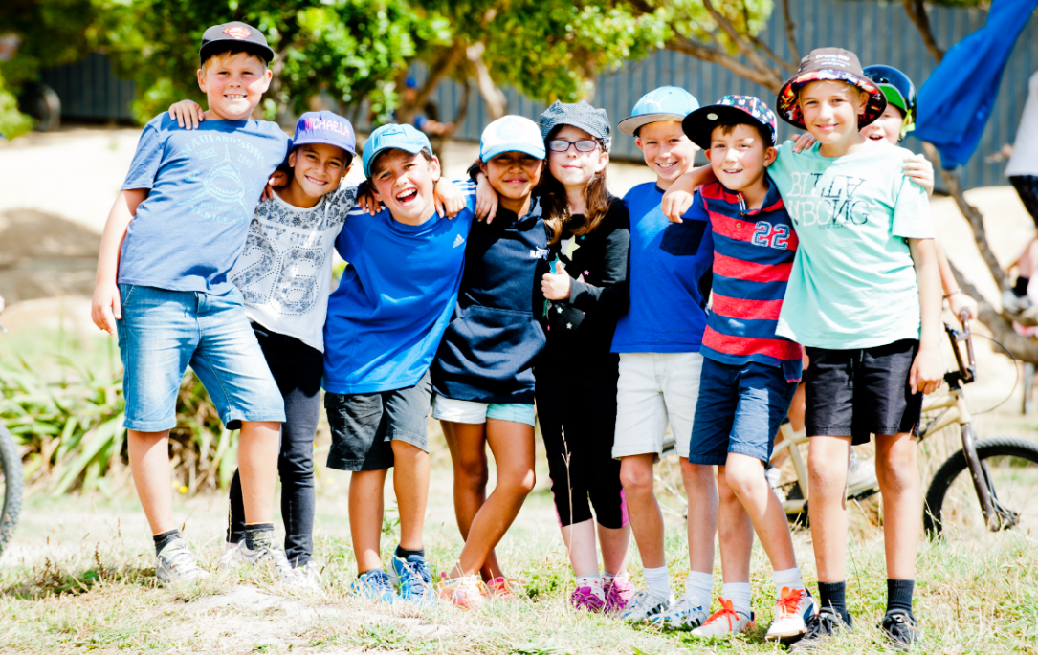

Teachers and Teacher Aides Working Together
Fostering Peer Relationships
Module 8 Presentation

Slide 2
Introducing the module
This module is about how teacher aides can help strengthen relationships and friendships between students.
It is for both teachers and teacher aides.
Please take your time to think and reflect.

Slide 3
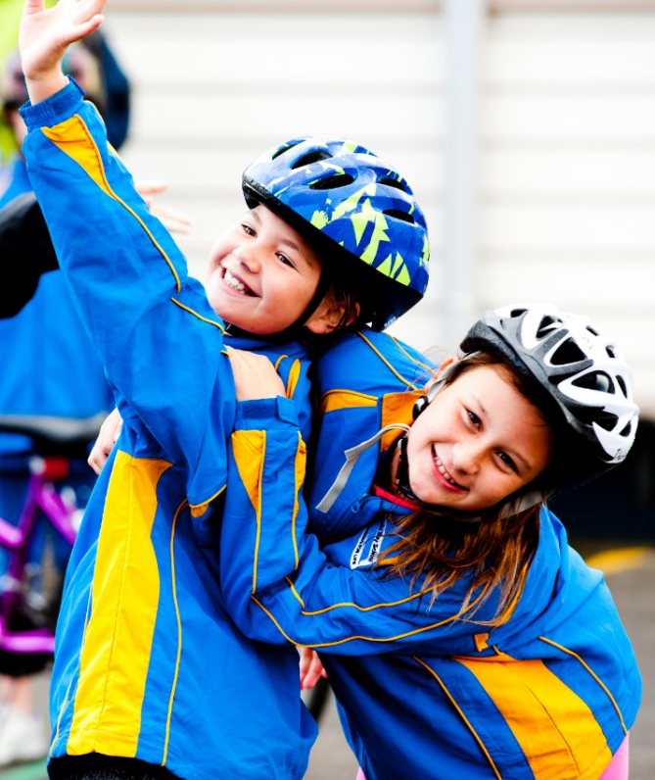
Why this module?
Research says teacher aide support can sometimes hinder friendships developing between students.
Teacher aides can help build connections between peers and increase students’ sense of belonging.

Slide 4

Belonging
Caring and supportive relationships are critical to students’ learning and well-being.
When we are connected, we feel like we belong.
It’s important to foster students’ connections with each other.

Slide 5
Showing students that they belong
In an inclusive classroom:
all students are respected
everyone’s identity, language and culture is celebrated
we see this in the relationships, environment and classroom programmes.
How do you recognise and celebrate your students’ identities, language and cultures?

Slide 6
Build a sense of belonging
In inclusive schools:
staff model behaviour and teach students to take responsibility for each other
staff have high expectations and believe all students can learn and succeed.
If students truly belong, they are expected to participate.

Slide 7
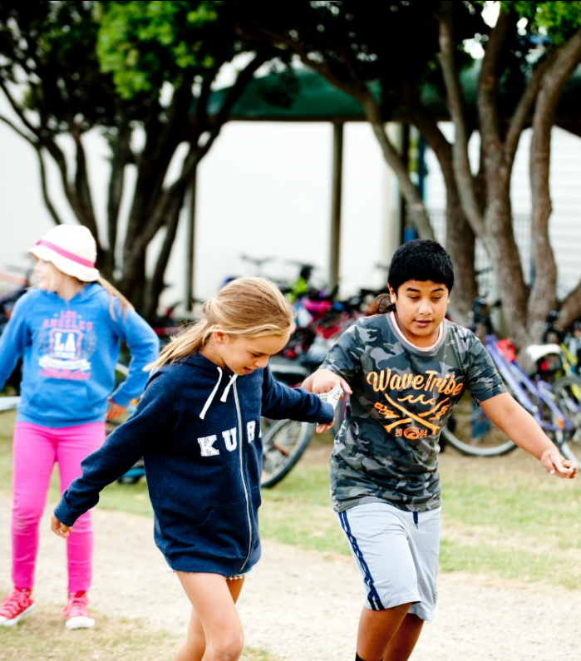
Peer-to-peer learning
Students learn through peer-to-peer interactions.
Teachers can foster this through shared activities, with students working:
  as partners
  in teams and groups
  with the whole class.

Slide 8
Making space for peer learning
If teacher aides provide one-to-one support, the student can become dependent on them.
Teacher aides need to read a situation. Is it best to step in or stand back?
Standing back provides space for peer interaction.
How do you make sure students with additional learning needs get as much time with their peers as their classmates?

Slide 9
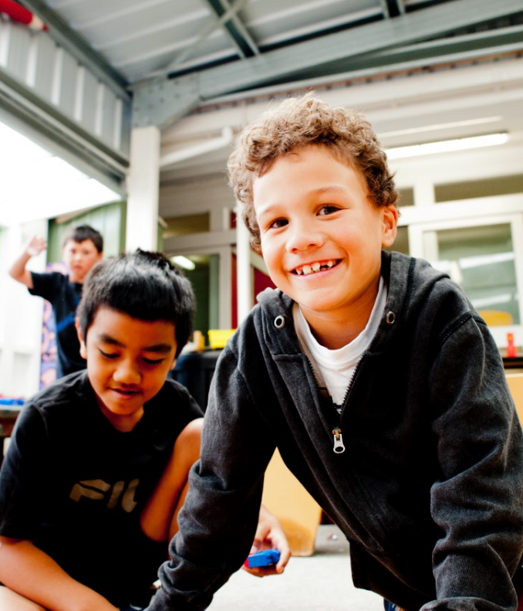
Fostering friendships
Teacher aides can:
look for common interests between students
offer help to students who need support to join in
check how physically close they are to the student and for how often; are they helping the student to make friends or hindering?

Slide 10
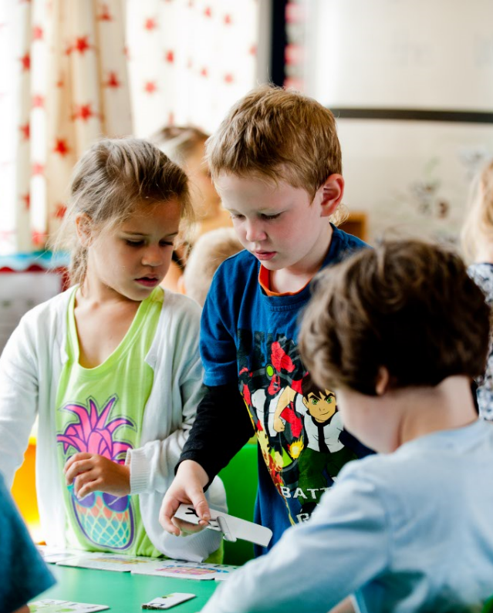
Working together
Teachers and teacher aides plan how to ensure students can develop relationships, connect with and learn from their peers.

Slide 11
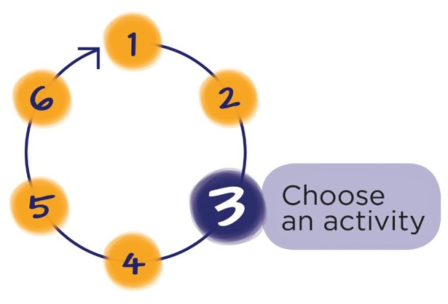
Next Step
Download the workbook for this module at:
teachersandteacheraides.tki.org.nz/Our-work-together/Module-8
To find out more about Teachers and Teacher Aides Working Together and to access the other modules go to:
teachersandteacheraides.tki.org.nz
We wish you well in your learning!
Ngā mihi!
It’s time to choose an activity from the workbook for this module.

