Slide 1
Teachers and Teacher Aides Working Together
Creating Inclusive Classrooms
Module 9 Presentation

Slide 2
Introducing the module
This module is about the ways that teacher aides can help create inclusive classrooms.
It is for both teachers and teacher aides.
Please take your time to think and reflect.

Slide 3
Why this module?
Effective ways to use teacher aide support in inclusive classrooms:
reducing one-to-one time with a teacher aide
reducing excessive teacher aide proximity
supporting students in the classroom.

Slide 4
One-to-one may limit teacher involvement
Research says:
teacher aides working one-to-one with a student can reduce their teacher time
teacher aides working more flexibly allow more student-teacher engagement.
Think about how teacher aides work in classrooms at your school? What are some ways that teacher aides work flexibly in classrooms?

Slide 5
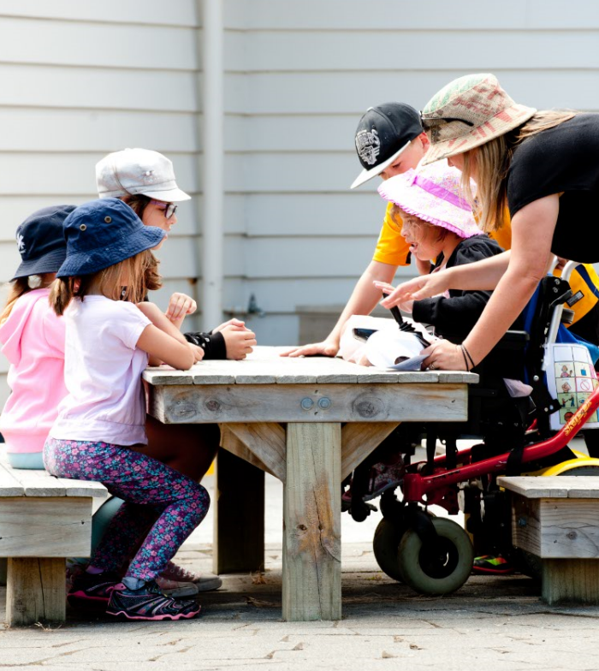
How close is too close?
‘Teacher aide proximity’ is how close you stay to the student.
Is it too close and is it necessary?
Staying too close can:
interfere with relationships
make students over-dependent on adults
reduce a student’s personal control.

Slide 6
Staying in the classroom
Students receiving one-to-one support from a teacher aide are more likely to be separated from their peers.
Less time in the classroom means:
less time with peers
less access to the teacher
less access to learning.

Slide 7
Using natural supports
Natural supports are the everyday relationships and opportunities that foster inclusion.
Natural supports reduce the need for other support such as time with a teacher aide.
Peers are natural supports.
In what ways are natural supports used in the classroom at your school?

Slide 8
Setting up for success
The way a classroom is set up can support participation.
Strategies can enhance students’ opportunities to participate and learn.
Think about how teacher aide support can help include all students.

Slide 9
Working together
Specialist teachers may have ideas about what may work in the classroom.
Meetings and discussion with students, families and whānau create opportunities for people to say how they want students to be supported.
Teachers and teacher aides need to meet regularly to discuss plans, strategies and ways of working in the classroom.

Slide 10
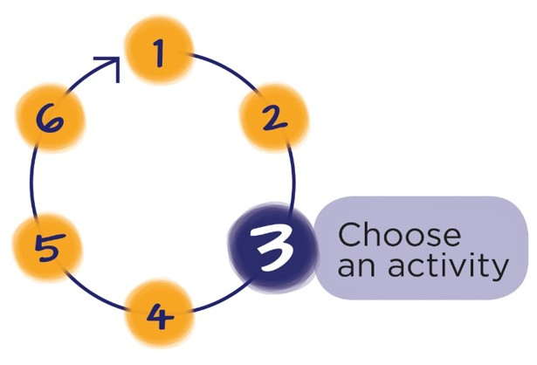
Next Step
Download the workbook for this module at:
teachersandteacheraides.tki.org.nz/Our-work-together/Module-9
To find out more about Teachers and Teacher Aides Working Together and to access the other modules go to:
teachersandteacheraides.tki.org.nz
We wish you well in your learning!
Ngā mihi!
It’s time to choose an activity from the workbook for this module.

