Slide 1



Teachers and Teacher Aides Working Together
Supporting Student Learning in the Whole Class
Module 10 Presentation

Slide 2
Introducing the module
This module is about how teacher aides can work in regular classroom settings in ways that support learning for all students and free up the teacher to work with students who need extra help.
It is for both teachers and teacher aides.
Please take your time to think and reflect.

Slide 3

Why this module?
All students need access to the teacher.
Students who are struggling often get more help from a teacher aide than a teacher.
Research shows more time with a teacher aide doesn’t mean improved learning.

Slide 4
Why this module?
It works best when teacher aides supplement high quality teaching.
Who works the most with students who need extra help in your school?
Are teacher aides confident to work with the class to support student learning?

Slide 5
Share the plan for the lesson
Teacher aides need to know what the plan is.
Talk about:
what students will be learning
the tasks and what success looks like
how the lesson will be set up
what the teacher aide needs to watch, listen for and do to help students learn.
How can you share the plan for the lesson without a formal meeting?

Slide 6
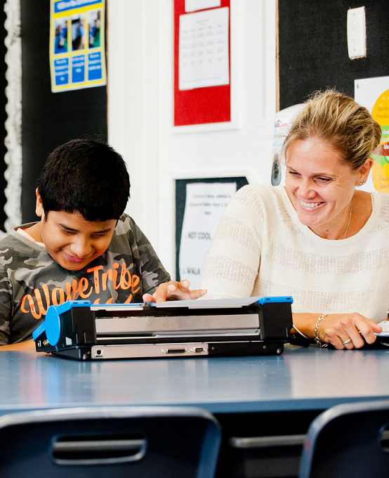
Model effective teaching
Show teacher aides the strategies they need to use.
Modelling can happen:
during whole class or group
teaching sessions
when demonstrating a specific strategy with a student.

Slide 7

Modelling – tips
Teachers:
explain the strategy, why it helps and when it should be used
draw the teacher aide’s attention to what success looks like.
Teacher aides:
get alongside the students
listen and watch carefully for the teacher’s words, actions and responses to students.

Slide 8
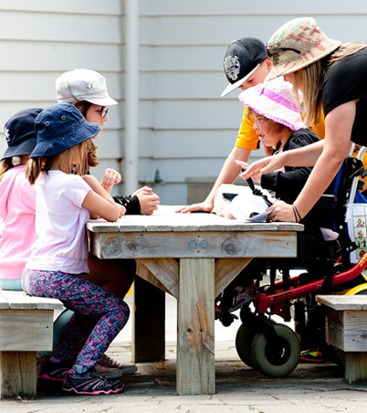
Working together in the lesson
The teacher can work with students who need extra help.
Teacher aides can work with the whole class on tasks the teacher has set.
Observe the students, move around the room and only provide support when a student needs it.

Slide 9
Scan, rove, listen in and support attention
Scanning:
look carefully to see whether students are actively involved in the task.
Roving:
move between the students and groups and take a closer look at each group as they work.
Listening in:
join a group and listen carefully to their conversation – avoid interrupting.

Slide 10
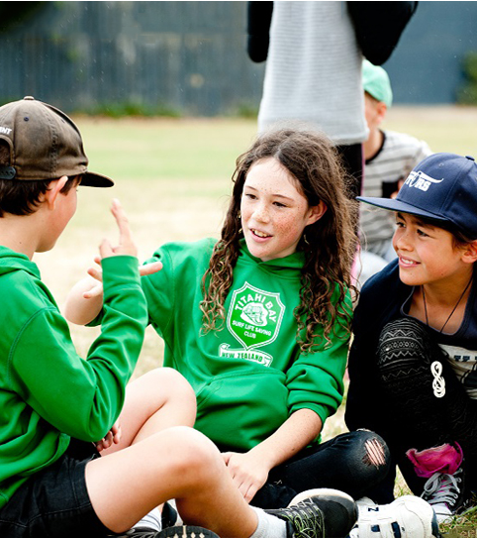
Support attention
Use simple questions and statements to help students stay on task, for example:
  “Show me where you are up to.”
  “Show me what you’ve done so far.”
  “Can you tell me what the next
  step is?”
  “Is there someone in your group who knows what to do?”

Slide 11

Supporting all students in the classroom
Standing back, observing who needs help and only providing support when students most need it helps all students.
You are helping students to develop independent learning skills.
Scanning, roving, listening in and supporting attention feels different to providing one-to-one support, but it’s an important strategy.

Slide 12
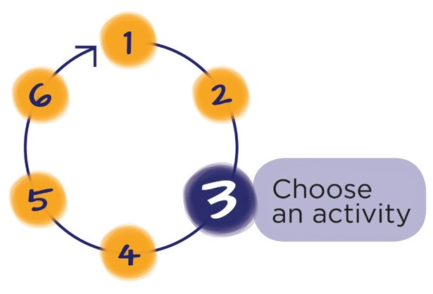
Next Step
Download the workbook for this module at:
teachersandteacheraides.tki.org.nz/supporting-student-learning/Module-10
To find out more about Teachers and Teacher Aides Working Together and to access the other modules go to:
teachersandteacheraides.tki.org.nz
We wish you well in your learning!
Ngā mihi!
It’s time to choose an activity from the workbook for this module.

